Slide 1
Intro to Xamarin
Mike Bluestein
Developer Evangelist, Xamarin

Slide 2

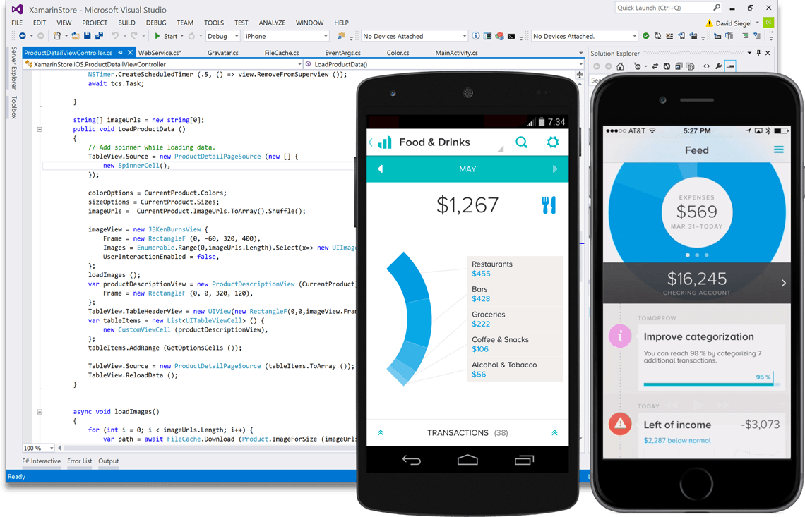
Create native iOS, Android, Mac and
Windows apps in Visual Studio and C#

Slide 3
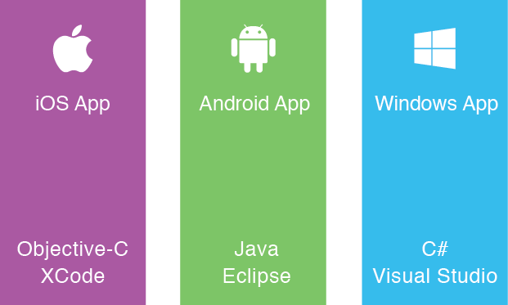
Silo Approach
Build Apps Multiple Times
Multiple Teams
Multiple Code Bases
Different toolsets
Notes:
Multiple Teams
Multiple Code Bases
Expensive & Slow
Positive = Great apps delivered to user’s platform
Negative = Development hampered by multiple code bases & fragmentation

Slide 4
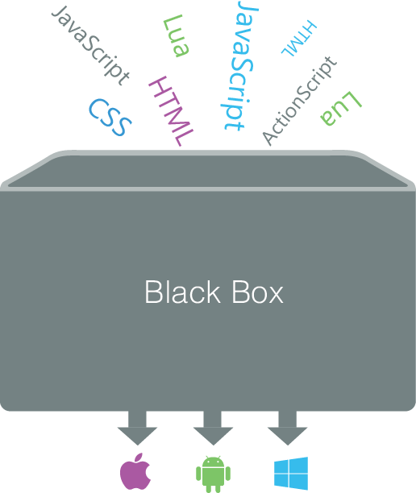
Write Once, Run Anywhere Approach
Lowest common denominator
Browser fragmentation
Developing & designing for 1 platform, happen to get other platforms
Notes:
Unhappy Users
Unhappy Developers
Increase in Abandoned Apps
Limited to what is implemented

Slide 5
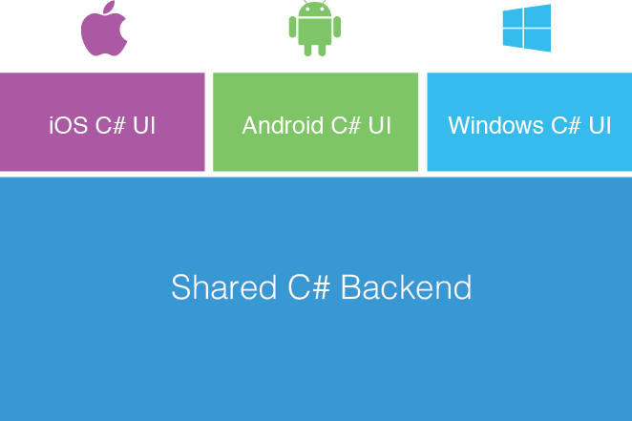
Xamarin’s Approach
Native User Interface
Native Performance
Shared code across platforms
C# & .NET Framework
Full API Coverage

Slide 6



Over a Decade of Enterprise Production Use
Xamarin 3
Xamarin 2.0
SAP Partnership
Component Store
Google Glass Support
First release of
Xamarin.Mac
Xamarin Test Cloud
Android Wear Support
Evolve 2013
Fire TV Support
Salesforce partnership
Xamarin Evolve 2014
Launch Partner
Program
Microsoft Partnership
Xamarin
Founded
Visionary in Gartner Magic Quadrant
First release of
Xamarin.Android
Visual Studio Partner
of the Year
Xamarin.iOS launches (originally known as MonoTouch)
200,000
Developers
500,000
Developers
100+ Partners
100+ Components
800,000
Developers
200+ Partners
200+ Components
Ximian Acquired
by Novell
Mono
Launches
Ximian
Founded
//
2000
2001
2003
2009
2011
2012
2013
2014

Slide 7
How
Xamarin
Works

Slide 8
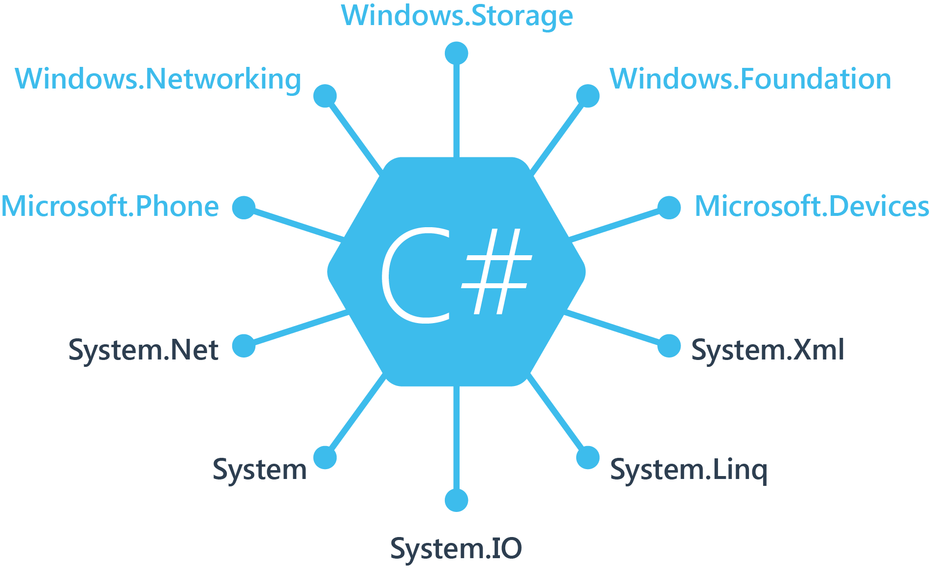
Windows APIs

Slide 9
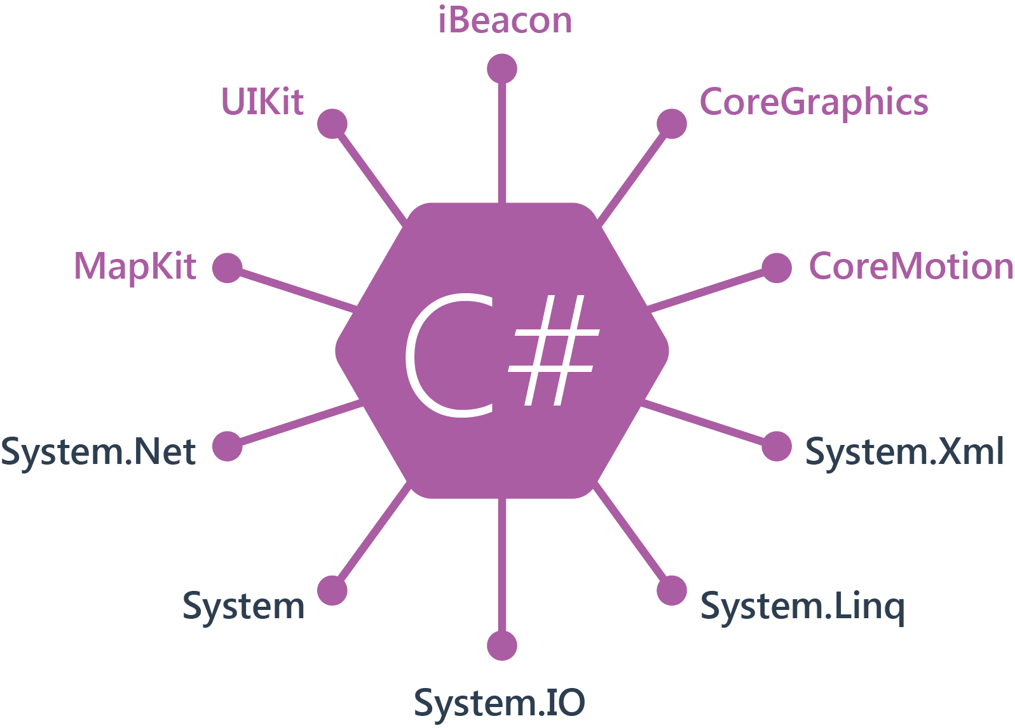
iOS APIs | 100% Coverage

Slide 10
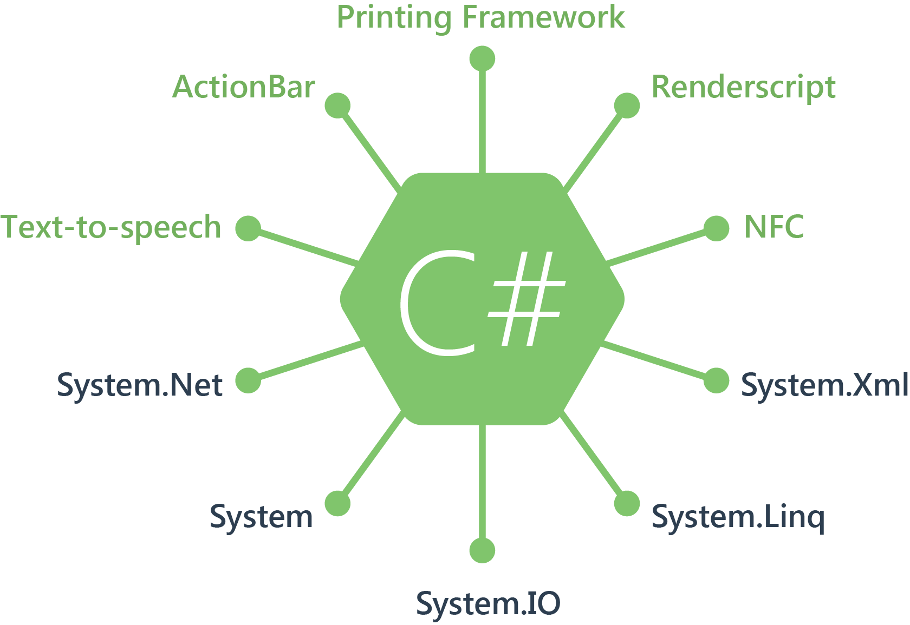
Android APIs | 100% Coverage

Slide 11
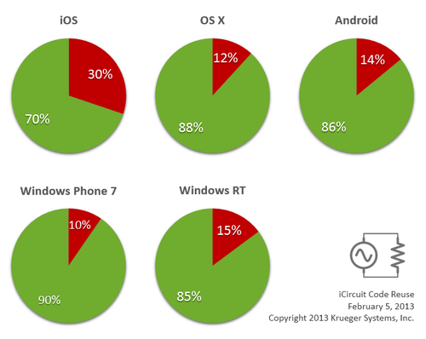

Code Sharing: Accelerate Development
Up to 90% Code Reuse
Leverage existing libraries
NuGet Support
Code-sharing stats from iCircuit, built with Xamarin and featured on the App Store.
Source: http://praeclarum.org/post/42378027611/icircuit-code-reuse-part-cinq

Slide 12


Development Environment
Xamarin Studio
PC or Mac
Visual Studio Plugin
VS 2010 and Higher

Slide 13
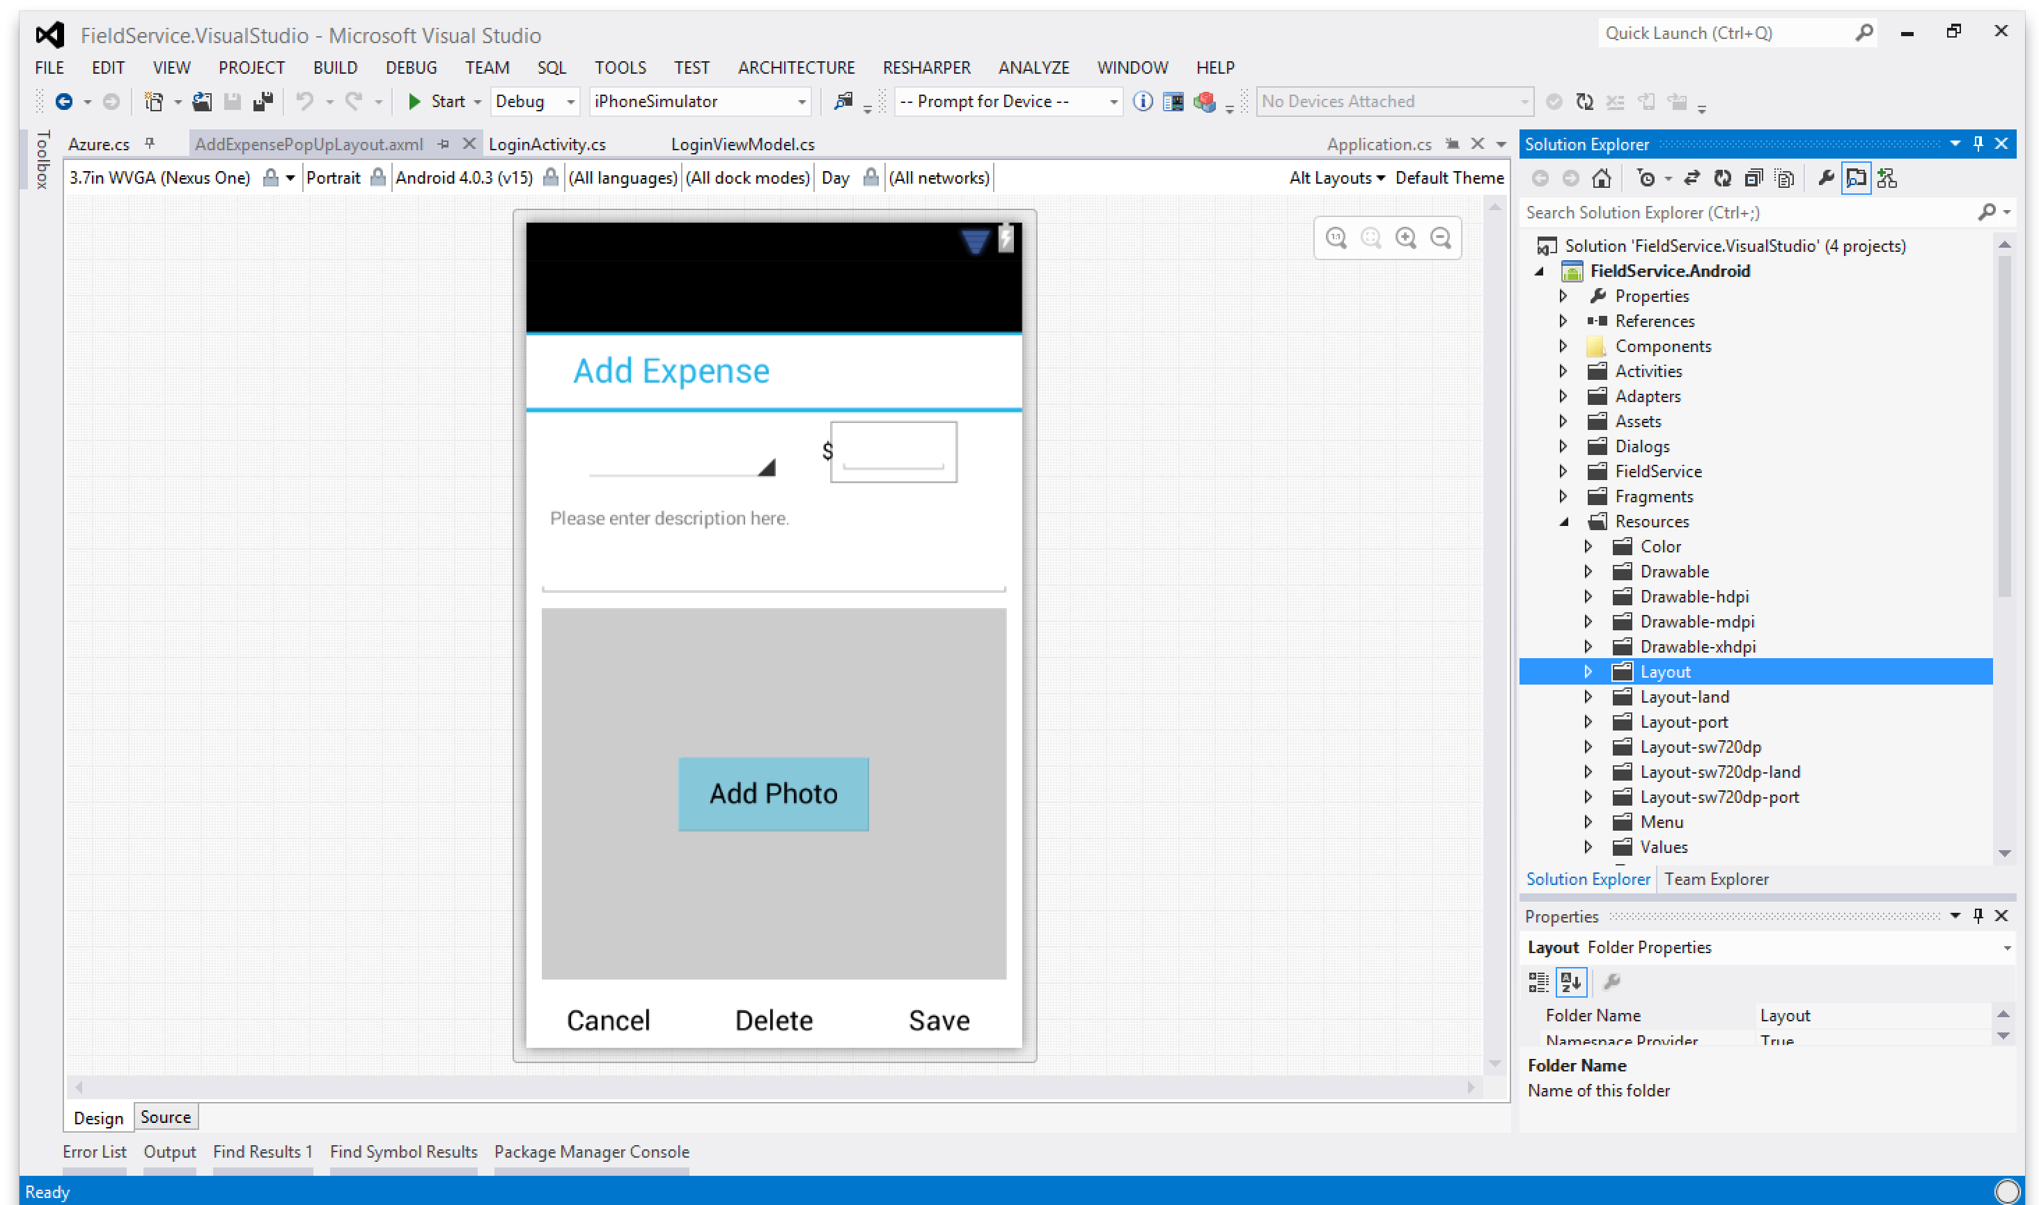
Android Designer

Slide 14
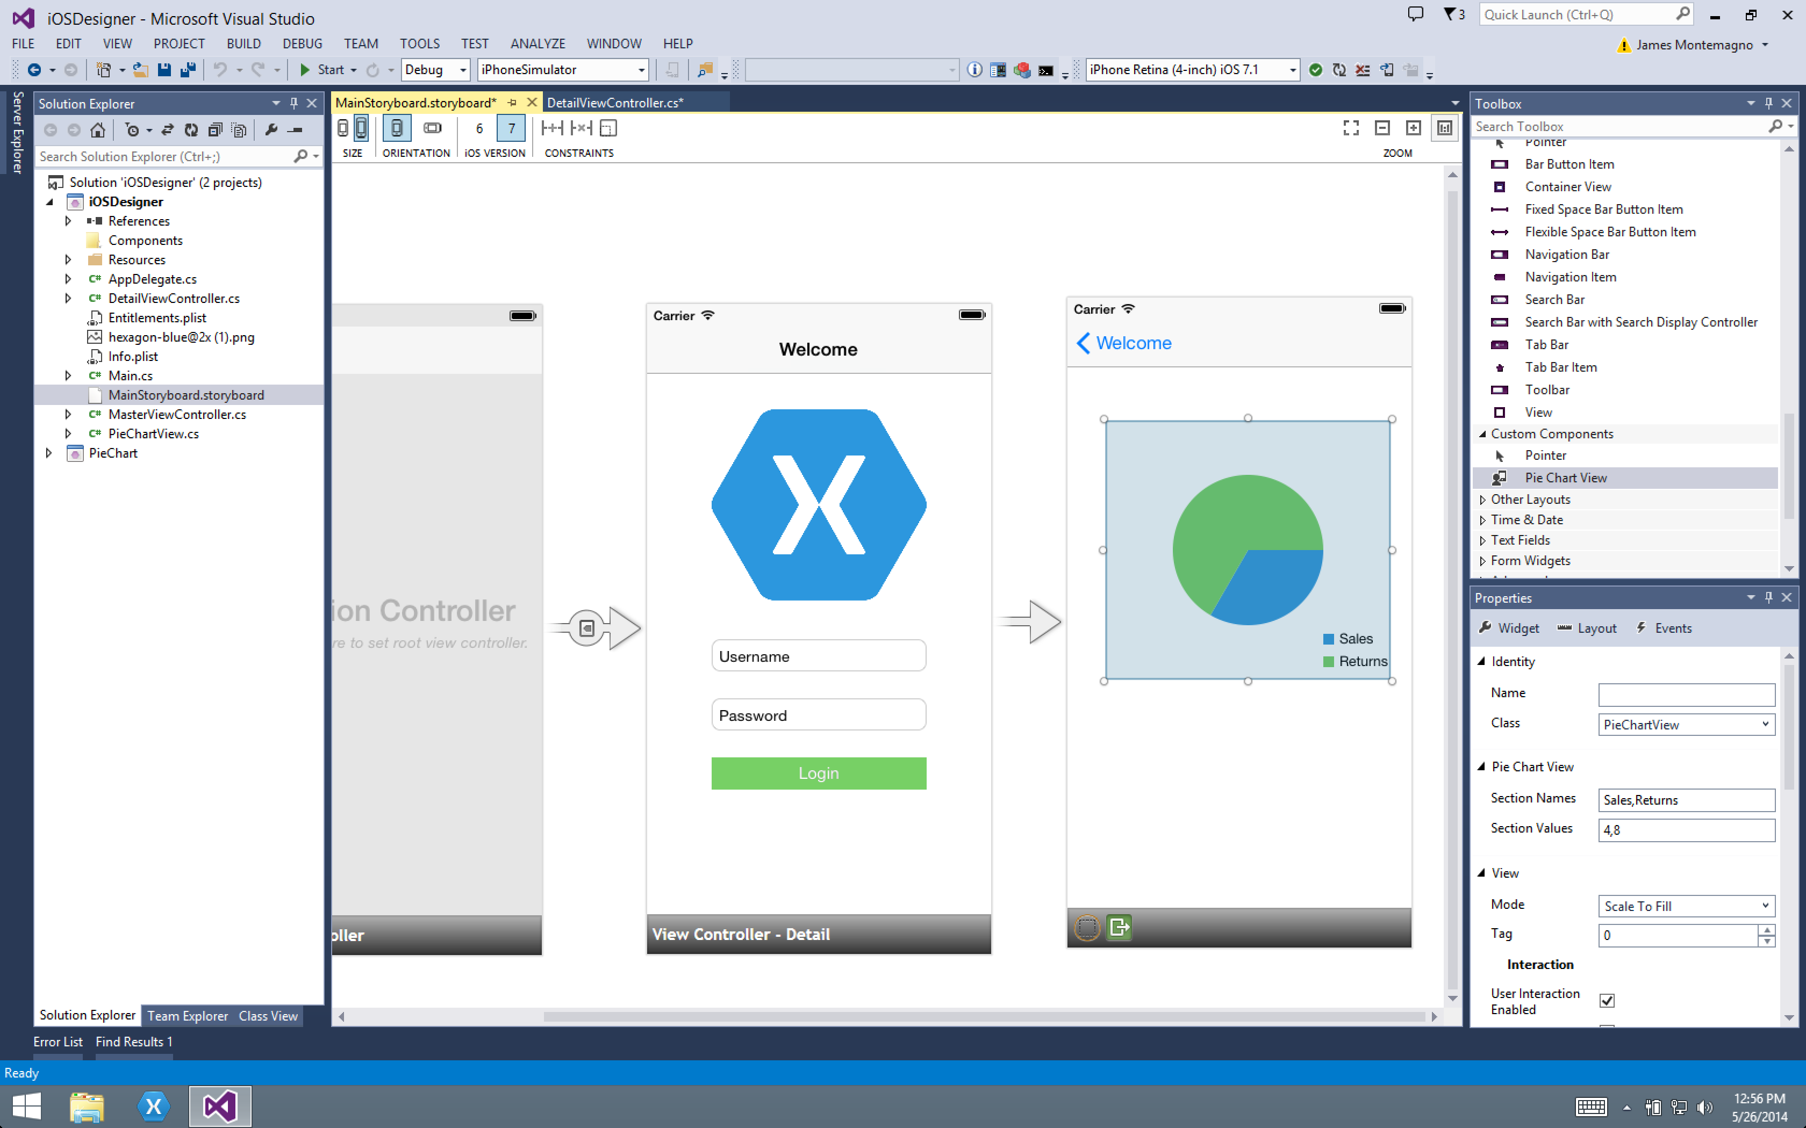
iOS Designer

Slide 15
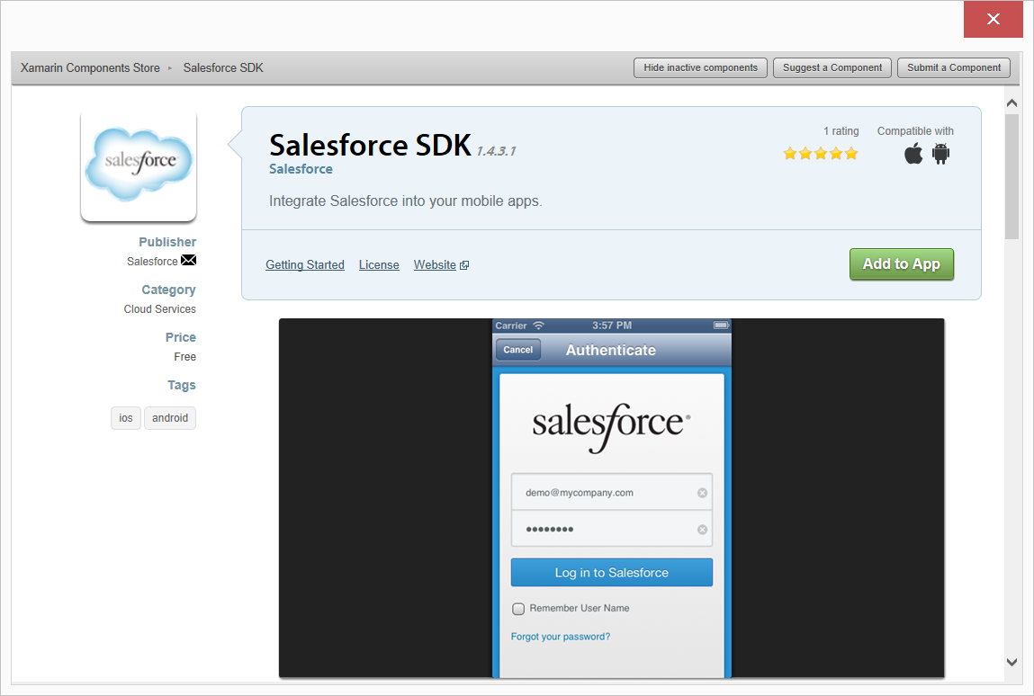
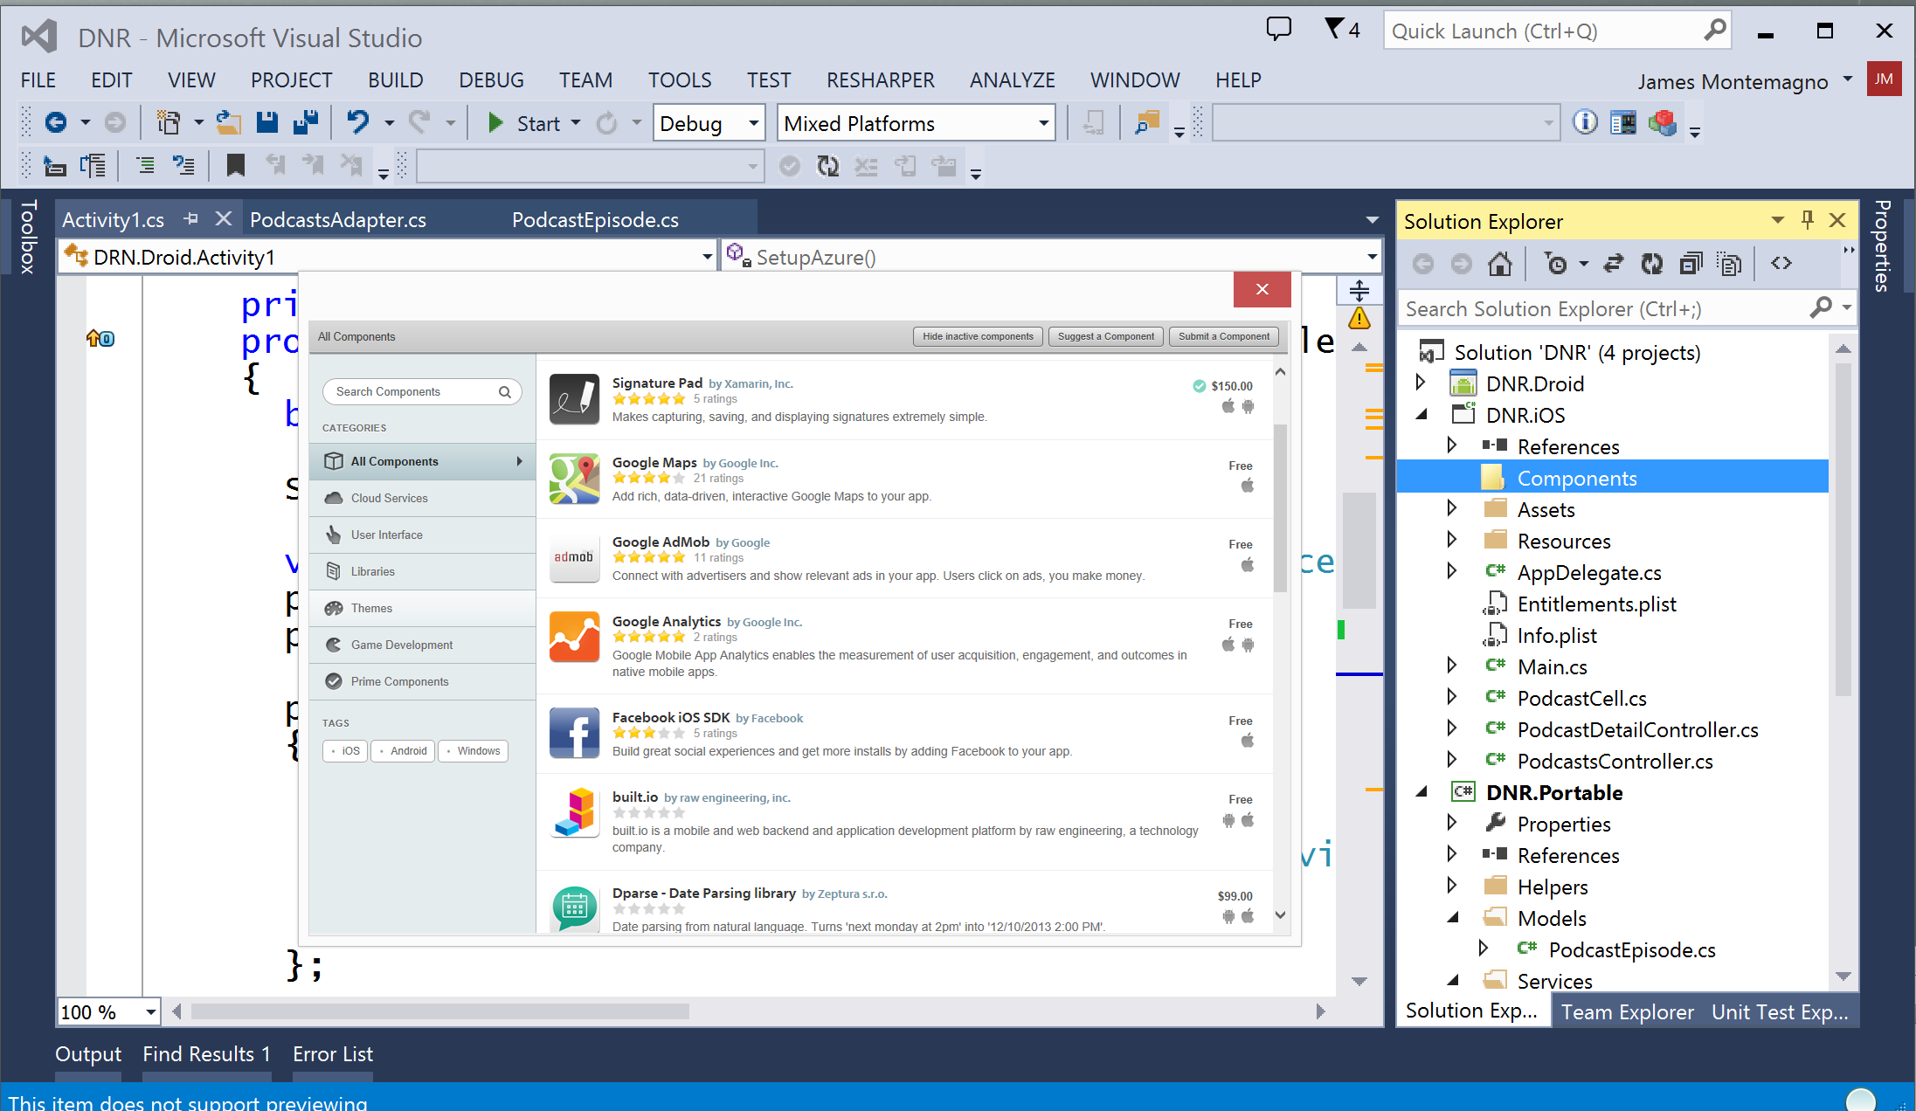
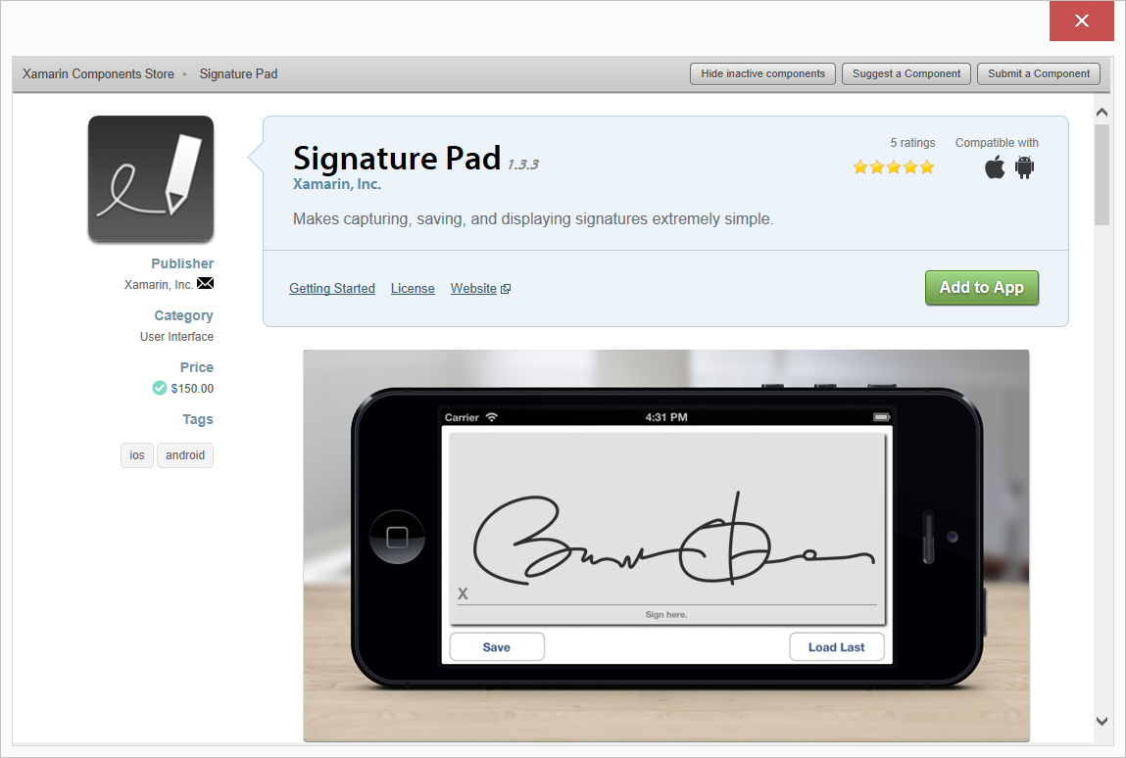
Xamarin Component Store

Slide 16
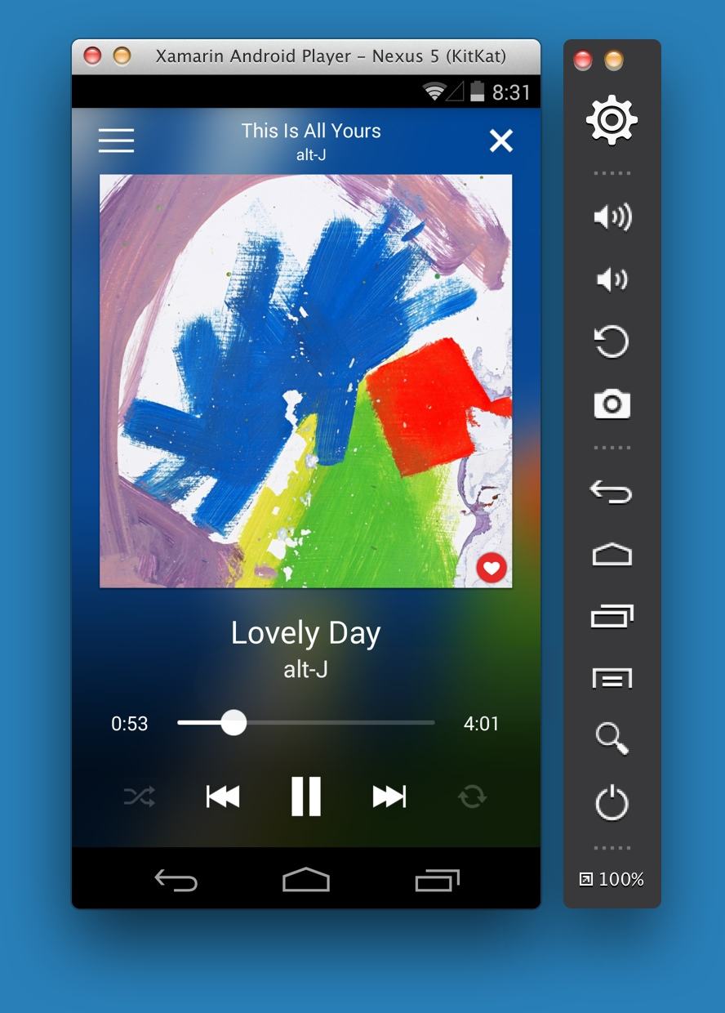

Xamarin Android Player
Super High Speed Android Emulator
Mac or PC
Runs Side-by-side WP Emulator
Free for Xamarin Subscribers:
Xamarin.com/Android-Player

Slide 17
Demo

Slide 18
Xamarin + Xamarin.Forms
With Xamarin.Forms:
more code-sharing, native controls
Traditional Xamarin approach
Shared UI Code

Slide 19
What’s Included
40+ Pages, Layouts, and Controls
Build from code behind or XAML
Two-way Data Binding
Navigation
Animation API
Dependency Service
Messaging Center
Shared UI Code

Slide 20
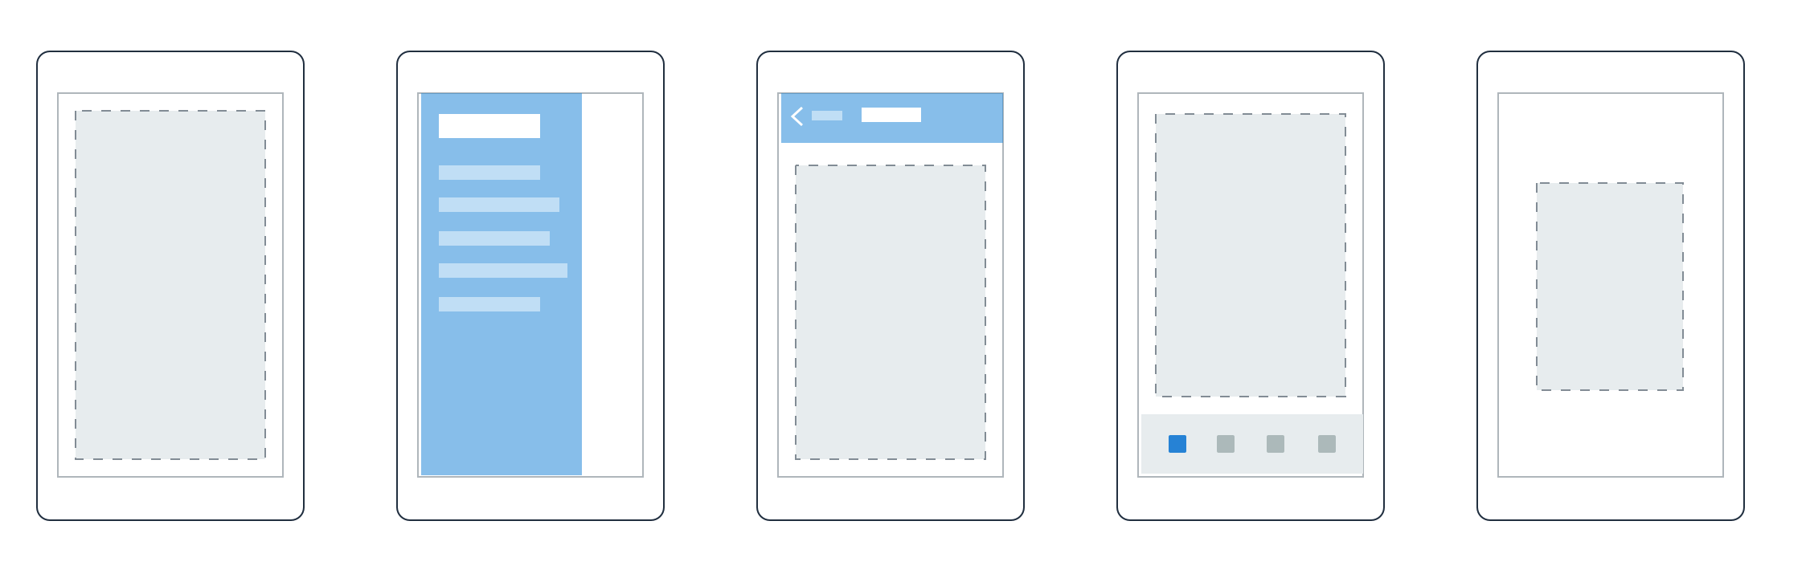

Pages
Content
MasterDetail
Navigation
Tabbed
Carousel

Slide 21
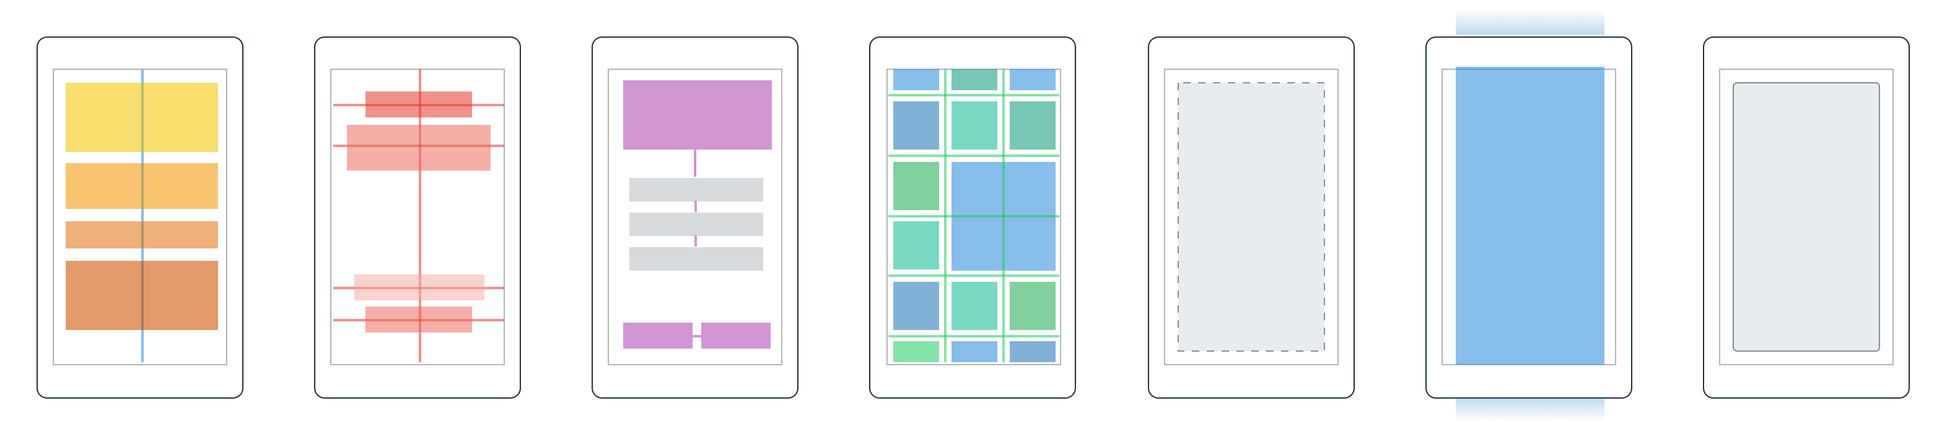
Layouts
Stack
Absolute
Relative
Grid
ContentView
ScrollView
Frame

Slide 22
Controls
ActivityIndicator
BoxView
Button
DatePicker
Editor
Entry
Image
Label
ListView
Map
OpenGLView
Picker
ProgressBar
SearchBar
Slider
Stepper
TableView
TimePicker
WebView
EntryCell
ImageCell
SwitchCell
TextCell
ViewCell

Slide 23
But Wait, There’s More!

Slide 24

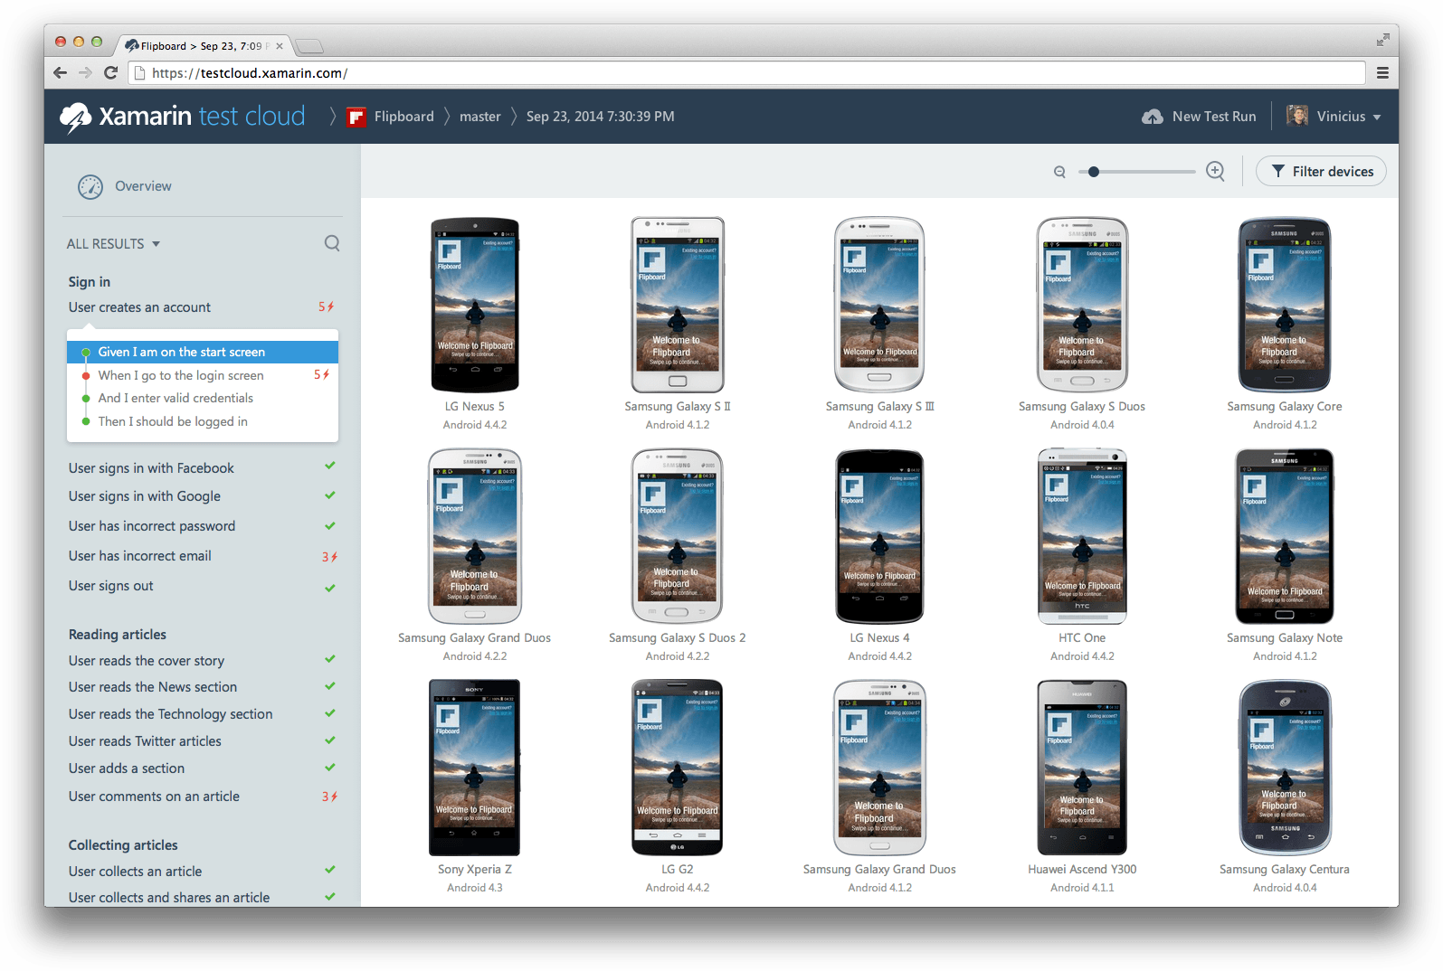
Automatically test your app on thousands of real devices in the cloud.

Slide 25
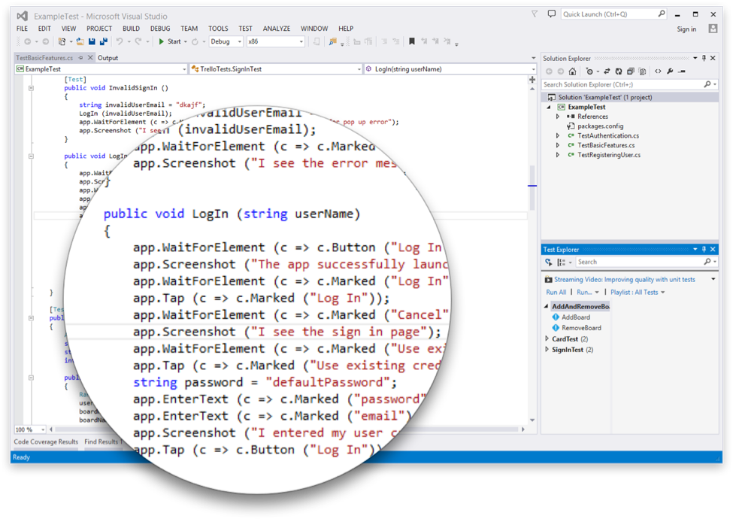
Test Cloud
Create Automated User Interface tests all in C#
Upload to the Test Cloud or run against a Device or Simulator
Run directly from Visual Studio or Xamarin Studio
Exposed via a NuGet Package
Free to use a Simulator*

Slide 26

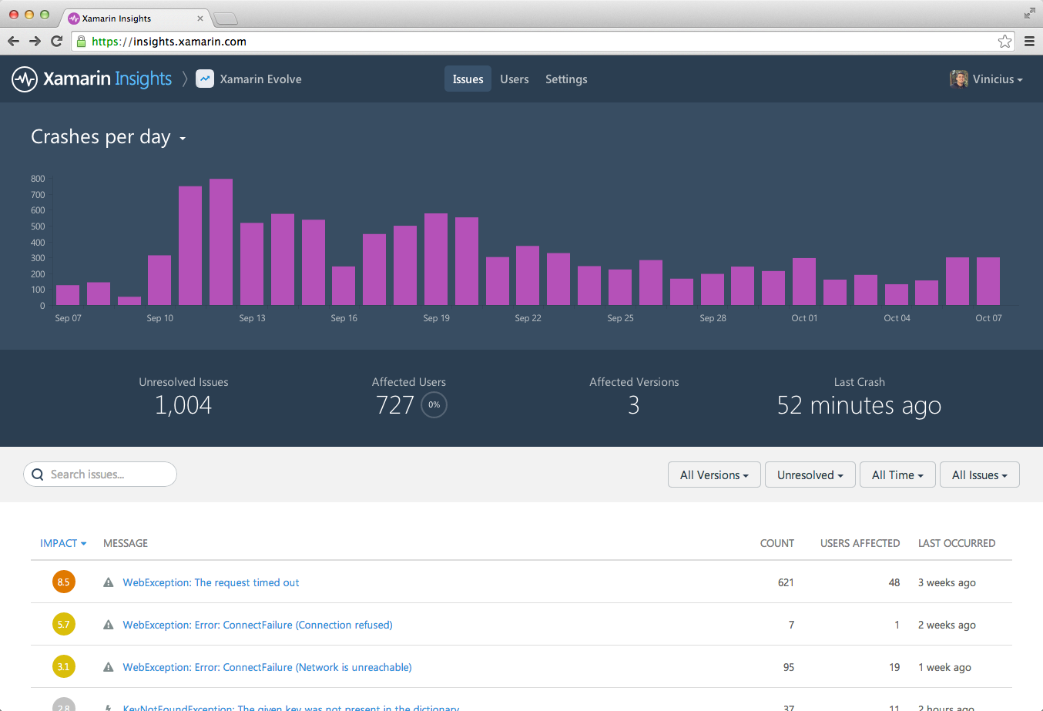
Real-time monitoring. Track crashes and exceptions to understand what is happening with live users.

Slide 27
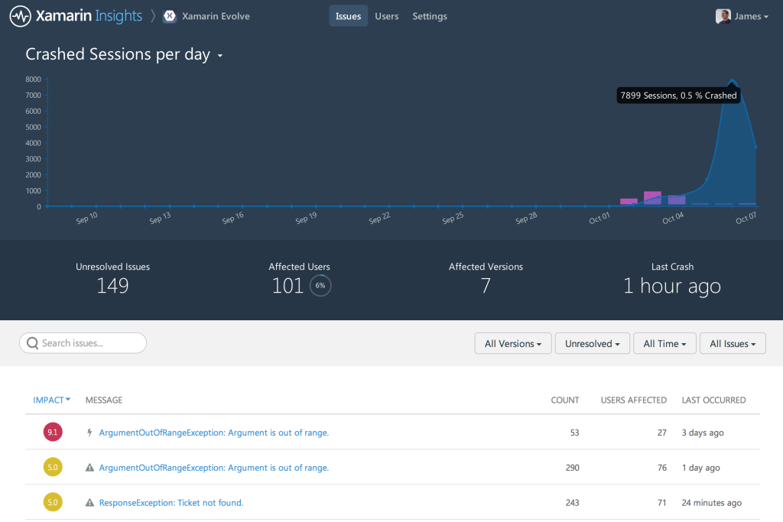
Report
Automatically report any uncaught managed or native exception.
Report your own caught exceptions with simple cross-platform API

Slide 28
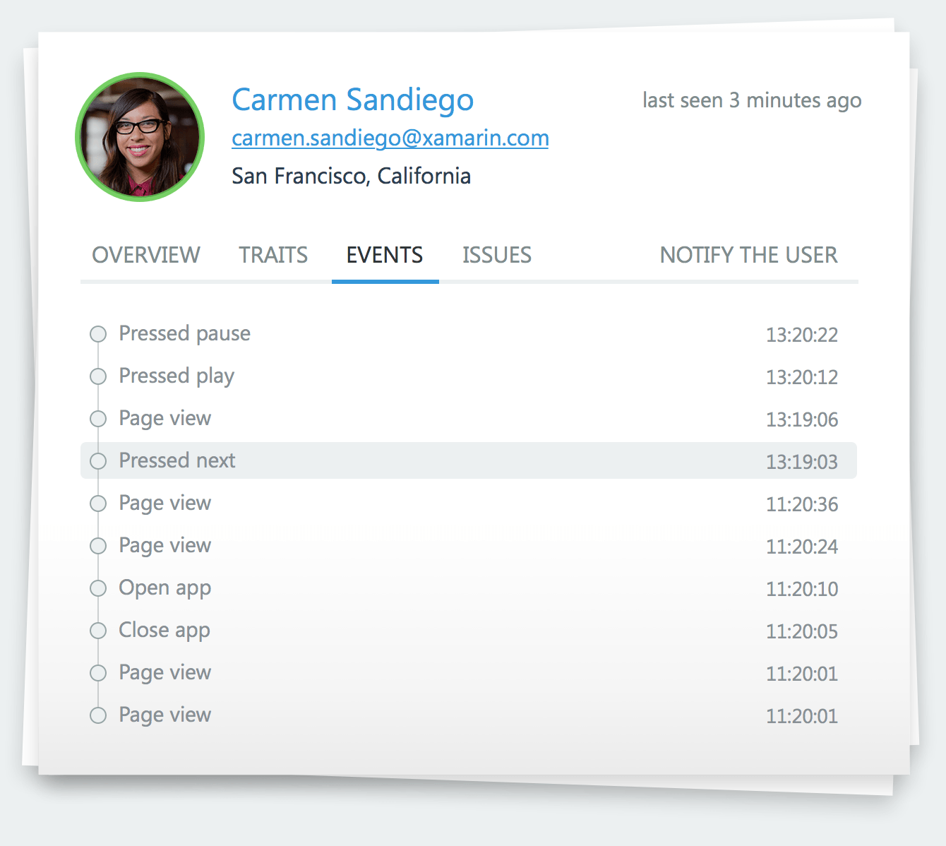
Track
Track any event that occurs in your application.
Even track performance of how long an operation takes.

Slide 29
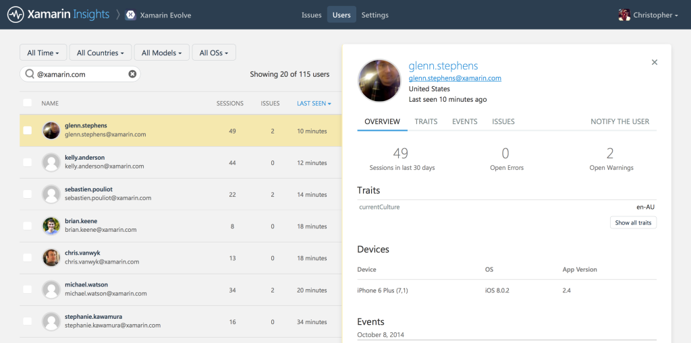
Identify
Combine event tracking with user identification to resolve issues faster.

Slide 30





Integrate
Simple integrations into popular services for mission critical notifications.

Slide 31
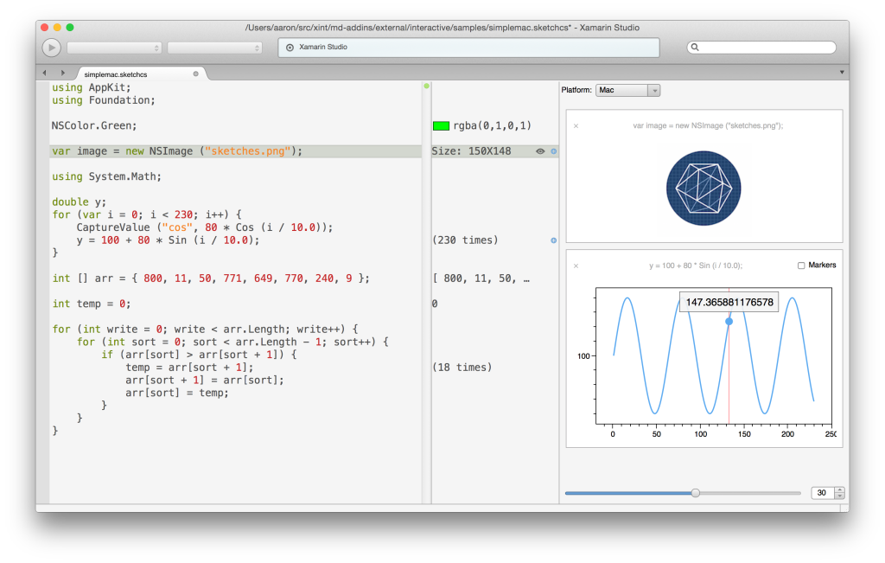
Sketches
Live Coding Environment
Xamarin Studio
VS coming soon
Supports:
iOS
Android
Mac
Xamarin.Forms
developer.xamarin.com/guides/cross-platform/sketches/

Slide 32
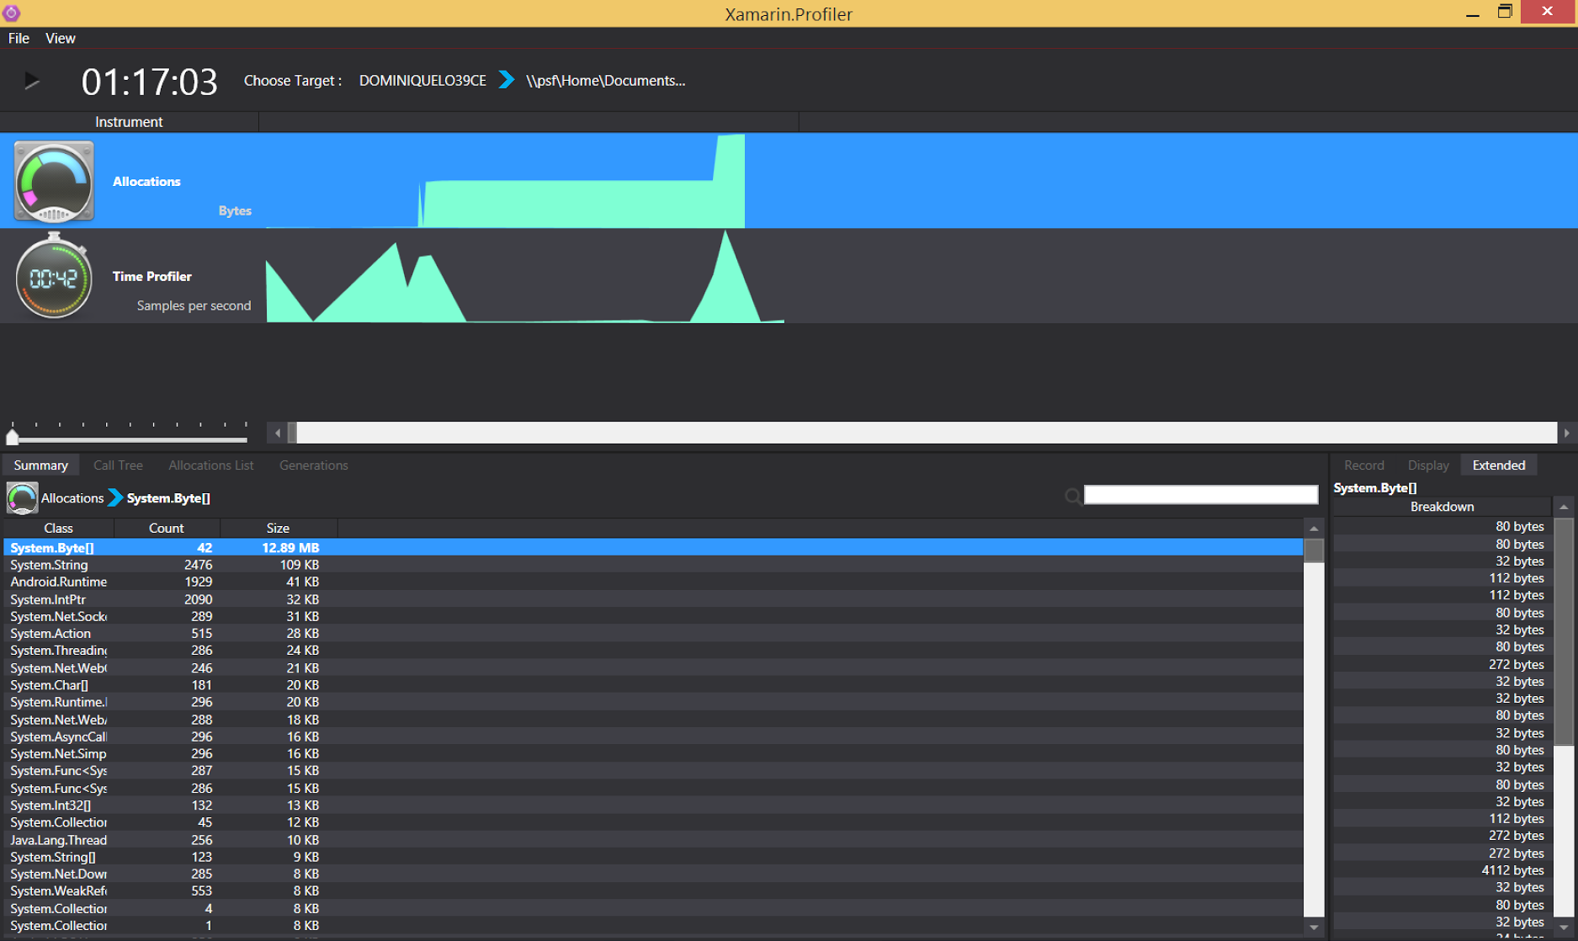
Xamarin Profiler Preview
Analyze and Polish your C# Mobile Apps
iOS, Android, and Xamarin.Forms
Windows or Mac
Xamarin.com/profiler

Slide 33
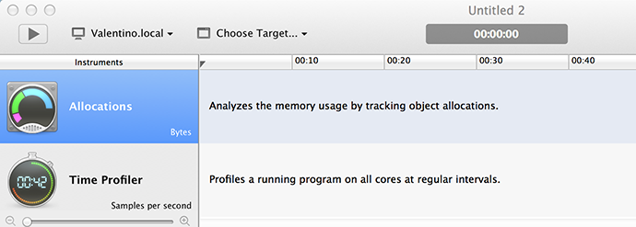
Two Key Instruments
Allocations
Time Profiler

Slide 34
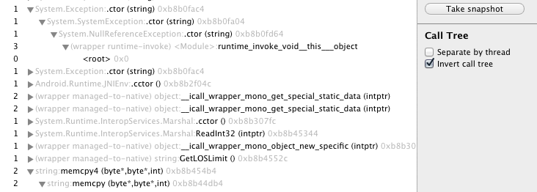
Call Tree
Browse functions easily
Option to invert and separate by threads

Slide 35
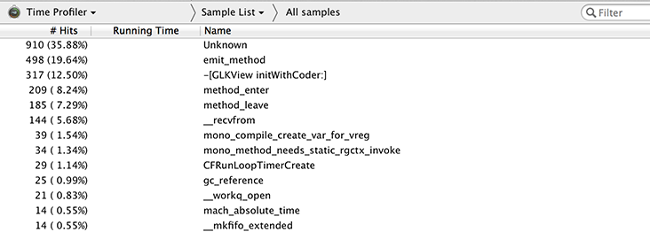
Sampling
See where your app is spending the most time.

Slide 36
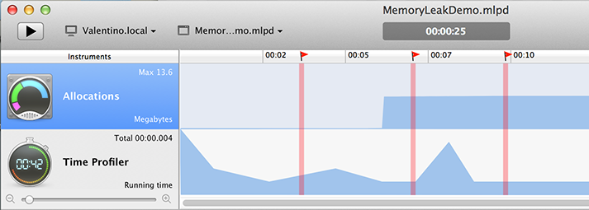
Memory Snapshots
See how memory is used at different points in time.

Slide 37
Thank You!
@mikebluestein

